Slide 1

Interactive Analytics Dashboard for Global Income Distribution
Infosys Springboard | Virtual Internship 6.0 | Batch 13
Mentor Name: Sri Kumar
CO-Ordinator Name: Praveen
Live: https://global-income-distribution.vercel.app

Slide 2
01 | Project Overview
About the Project
📊 Data Analytics
Clean & transform World Bank datasets
A research-grade full-stack web application developed during the Infosys Springboard Virtual Internship 6.0 (8 weeks).
The platform analyzes and visualizes global income inequality, transforming raw World Bank data into interactive, actionable insights for researchers, students, and policymakers.
It combines advanced data analytics with a modern full-stack web portal accessible to the public.
📈 Dashboard Development
Interactive Power BI analytical dashboard
🌐 Web Application
Full-stack React + Node.js web portal
Duration: 8 Weeks | Start: 02 Feb 2026 | Submission: 30 Mar 2026
🔒 Secure Admin Portal
JWT auth, user management & telemetry
Infosys Springboard | Interactive Analytics Dashboard – Global Income Distribution

Slide 3

02 | Project Workflow
Start
Data Collection
Data Preprocessing
Data Structuring & Transformation
Power BI Dashboard Development
01
02
03
04
05
06
Web App Integration
Testing & Review
Documentation & Final Report
End
Infosys Springboard | Interactive Analytics Dashboard – Global Income Distribution

Slide 4
03 | Master Sheet Preparation
Data Preparation Steps
Key Columns in Master Sheet
1.
Source —
World Bank database – Gini Index, GDP per capita, Unemployment rate, Income share by decile
Column Name | Description
Country_Name | Country name
Years | Data year (2001–2024)
Gini_Index (0-100) | Income inequality coefficient
GDP_Per_Capita ($) | Per Capita Income
Income_Share_By_Decile | Income Distribution
Unemployement_Rate (%) | Joblessness Rate
Country_Continent | Continent Name
GDP_Per_Capita_Category | Income Classification
Gini_Inequality_Level | Income Inequality Level
Middle_Class_Income_Share | Middle Class Share
Unemployment_Level | Unemployment Category
2.
Cleaning —
Removed irrelevant columns, standardized field names, converted inconsistent formats
3.
Missing Values —
Applied linear interpolation for sparse years; used country averages where interpolation not feasible
4.
Long Format —
Converted all indicator files from wide to long format (Country × Year rows)
5.
Merge —
Joined all datasets on Country + Year into a single unified master sheet
6.
Validation —
Verified numeric types, confirmed Year as integer, checked for blank/null values in Power BI
Infosys Springboard | Interactive Analytics Dashboard – Global Income Distribution

Slide 5
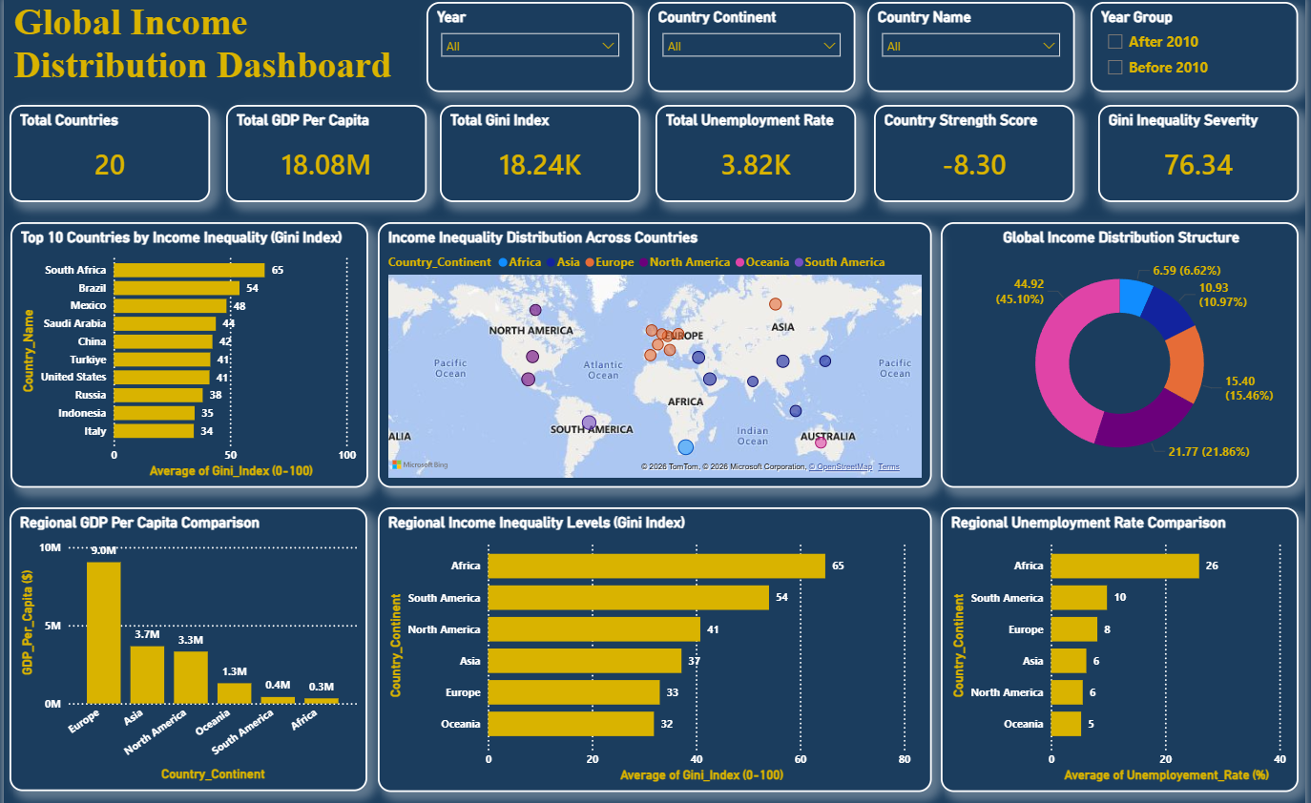
04 | Dashboard Overview (Power BI)
Sections Overview :
Slicers
Year : (2001-2024)
Country Continent : Continent Names
Country Names : (20) Countries
Year Group : After or Before 2010
Kpi Section
Total Countries : 20
Total GDP Per Capita : Economic Indicator
Total Gini Index : Inequality Index
Total Unemployment Rate : Jobless Rate
Country Strength Score : Economic Strength
Gini Inequality Severity : income inequality
1
2
3
4
5
Global Overview Section
Top 10 Countries by Income Inequality (Gini Index) : Vertical bar chart
Income Inequality Distribution Across Countries : Choropleth map
Global Income Distribution Structure : Donut Chart
Regional Comparison Section
Regional GDP Per Capita Comparison : Bar chart
Regional Income Inequality Levels (Gini Index) : Vertical bar Chart
Regional Unemployment Rate Comparison : Vertical bar chart
Infosys Springboard | Interactive Analytics Dashboard – Global Income Distribution

Slide 6
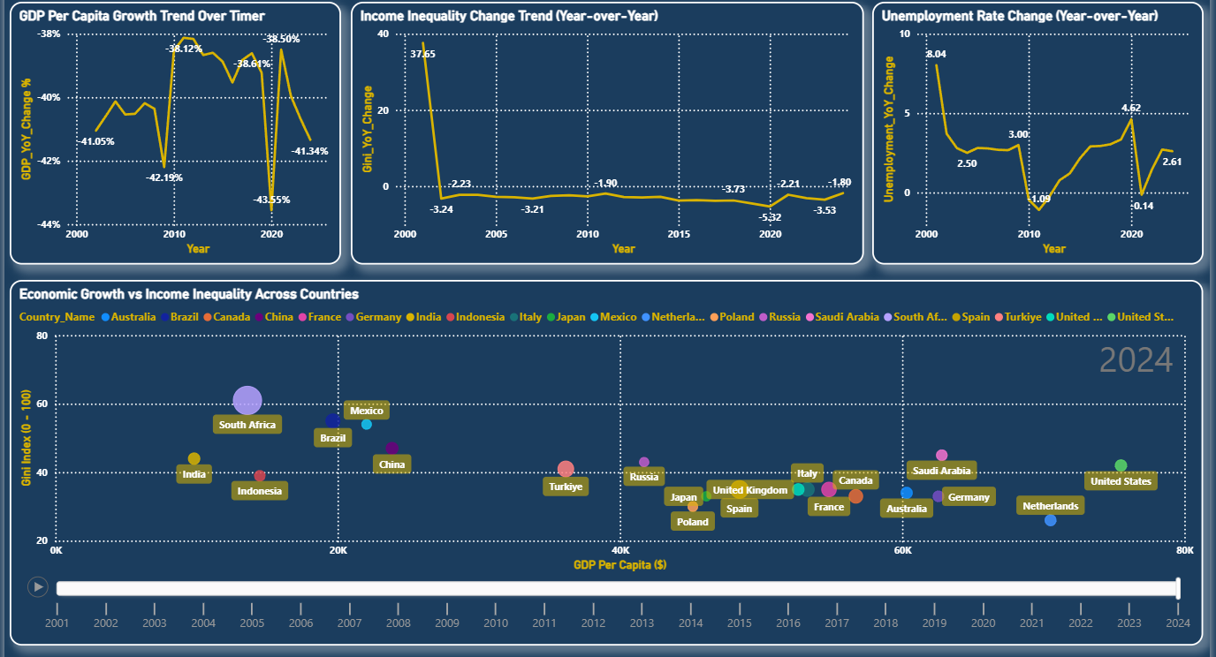
05 | Dashboard Overview & Global Insights
Trend Analysis Section (YOY Change )
GDP Per Capita Growth Trend Over Time : Line Chart
Income Inequality Change Trend : Line Chart
Regional Unemployment Rate Comparison : Line Chart
Indicators Comparison Section
Economic Growth vs Income Inequality Across Countries : Scatter Plot Chart
Global Insights
Polarization of Wealth
Consistent High Inequality
Global Labor Disconnect
Infosys Springboard | Interactive Analytics Dashboard – Global Income Distribution

Slide 7
06 | Website Implementation
Public Area
Authenticated Area
Admin Portal
Interactive Homepage with parallax animations
'About Inequality' — Gini Coefficient, Wealth Concentration explainers
'Visualizations Explained' — chart interpretation guides
Contact the Analyst form (routed to SQLite DB)
Sign Up / Log In with Email + Password (JWT-secured)
Embedded Power BI Dashboard via responsive iframe
Country Comparison Tool
Data Export & Downloads (spreadsheets / reports)
Session Tracking — page views, login frequency, session duration
KPI Dashboard — total users, active sessions, query counts
User Management — suspend, kick, or ban users
Moderation Logs — audit trail of admin actions
Query Management — read, reply & resolve contact form messages
CSV Export — one-click SQLite database dump to Excel
User → Frontend (React)
Hosting → Vercel + Render
Backend (Node.js / Express)
Database (SQLite)
Power BI Dashboard (Embedded)
Infosys Springboard | Interactive Analytics Dashboard – Global Income Distribution

Slide 8
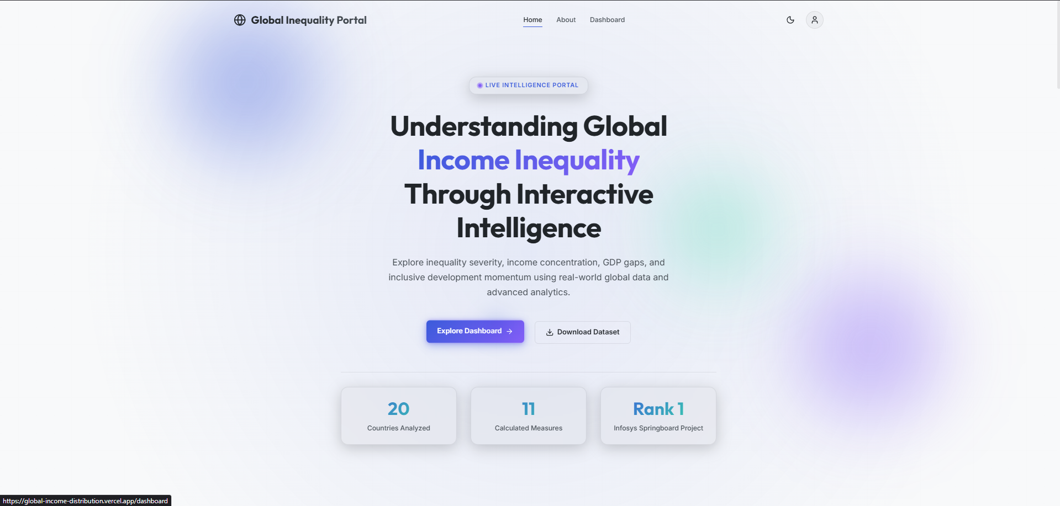
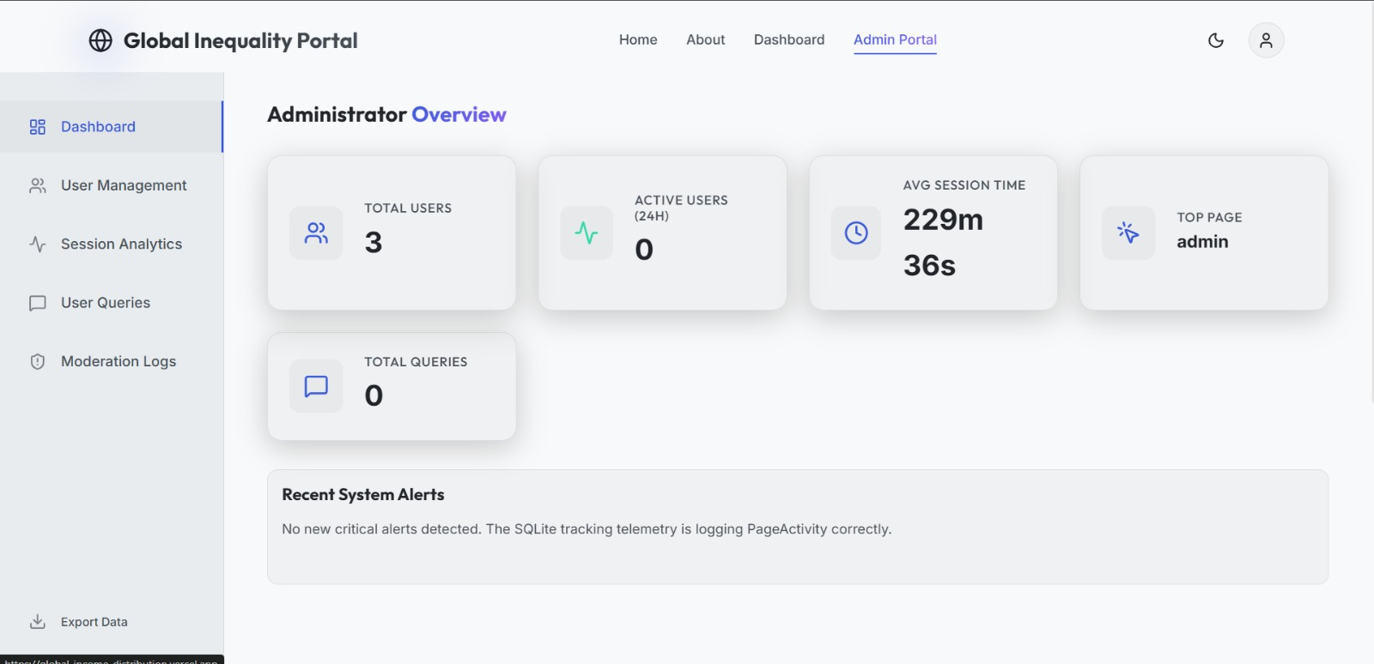
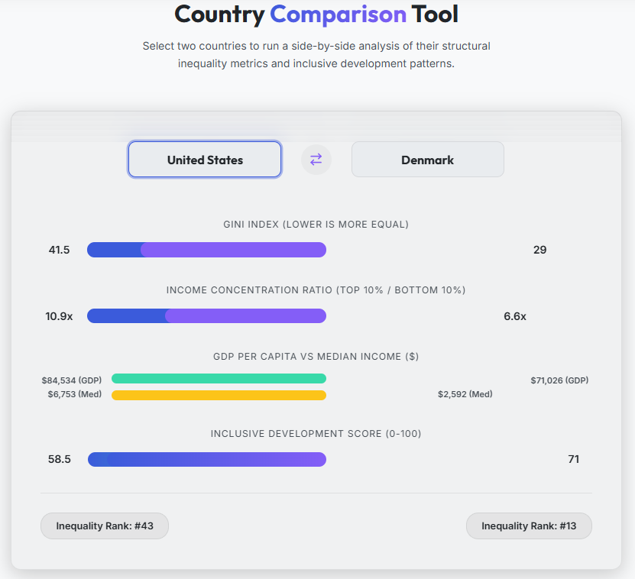
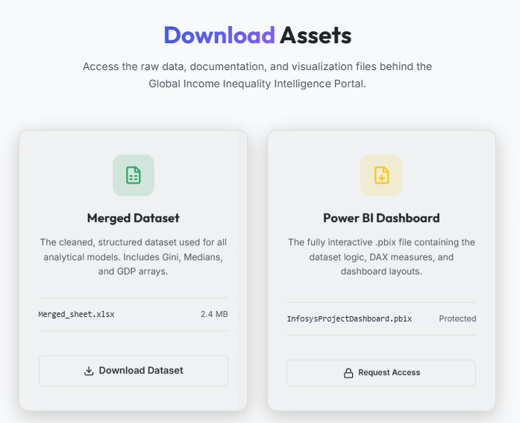
07 | Key Features & Highlights
• Interactive Power BI Dashboard Integration
• Country Comparison Tool
• JWT-Based Secure Authentication
• Admin Dashboard with User Management
• Real-time Data Filtering & Analysis
• Data Export (Excel Reports)
• Global Inequality Insights & KPIs
• Responsive Full-Stack Web Application
Infosys Springboard | Interactive Analytics Dashboard – Global Income Distribution

Slide 9
08 | Challenges Faced & Solutions Implemented
CHALLENGES
SOLUTIONS
⚡ Missing & Inconsistent Data
✅ Applied linear interpolation for sparse yearly data and used country-level averages for non-interpolable gaps; standardized all column names and formats
→
⚡ Creating Meaningful Composite KPIs
✅ Studied DAX documentation to build multi-variable measures like Inequality Severity Index (combining Gini + Top/Bottom 10% shares) and Inclusive Development Score
→
⚡ Embedding Power BI in React
✅ Used a responsive iframe embed of the published Power BI report URL, integrated directly into React Router's /dashboard component with CSS adjustments for fullscreen display
→
⚡ Implementing Secure JWT Authentication
✅ Implemented bcrypt password hashing on registration; configured JWT token generation on login, stored in localStorage; created <ProtectedRoute> HOC to guard private pages
→
⚡ Frontend–Backend Communication & CORS
✅ Abstracted all API URLs into .env config files; configured CORS middleware on Express to allow Vercel's frontend domain; debugged request/response headers systematically
→
Infosys Springboard | Interactive Analytics Dashboard – Global Income Distribution

Slide 10
09 | Project Outcomes
4
8
11
18
Milestones
Completed
Weeks
Internship Duration
DAX Measures
Columns
Master Sheet Fields
📊 Data Analytics Outcome
📈 Dashboard Outcome
Clean merged master sheet from World Bank data
11 composite DAX measures & 7 calculated columns
Countries categorized by inequality level and economic performance
4-section interactive Power BI dashboard
Real-time cross-filtering across all visuals
Published and embedded in live web application
🌐 Web Application Outcome
🎓 Learning Outcome
Live full-stack React + Node.js portal on Vercel/Render
JWT-secured authentication & admin portal
Session analytics, user management, data exports
Mastered DAX, Power BI, React, Node.js, SQLite, JWT
End-to-end project delivery from raw data to deployment
Improved documentation, teamwork & presentation skills
Infosys Springboard | Interactive Analytics Dashboard – Global Income Distribution

Slide 11
10 | Conclusion
Project Summary
The Interactive Analytics Dashboard and Web Portal for Global Income Distribution successfully merges complex socioeconomic data with a high-performance, accessible web interface. By transforming raw World Bank datasets into interactive Power BI visuals and embedding them within a secure full-stack React application, the project delivers a premium research tool for analysts, students, and policymakers worldwide.
🚀 Future Potential
Scalable architecture ready for additional datasets, ML-based predictions, and expanded global coverage
🏆 Infosys Springboard Virtual Internship 6.0 — Completed Successfully
Batch 13 | March 2026 | https://global-income-distribution.vercel.app

Slide 12
Thank You!
For Your Attention

